Slide 1


T1911
Sorting And Binary Search
A Quest Global Company
30/05/2025

Slide 2
Agenda
Topics Covered Today
Key Learnings / Concepts Understood:
Key Concepts with Definitions/ Code Snippet – Hands-on Practice
Challenges / Debugging Experience
Tasks/Assignments Completed
Additional Learning Resources / Notes
Q&A
Plan for Tomorrow

Slide 3
Topics Covered Today
Sort
StableSort
LowerBound
UpperBound
BinarySearch

Slide 4
Key Learnings/Concepts Understood
std::sort: Sorts in ascending order; not stable (equal elements may change order).
std::stable_sort: Sorts while preserving order of equal elements (stable).
std::lower_bound: Finds first element ≥ value in a sorted range.
std::upper_bound: Finds first element > value in a sorted range.
std::binary_search: Checks if a value exists in a sorted range (returns true or false).
Sorting required before using lower_bound, upper_bound, and binary_search.
Works with vector, array, deque and supports custom comparators.

Slide 5
Key Learnings/Concepts Understood
what is an Algorithm ?
An algorithm is a step-by-step procedure or set of rules designed to perform a specific task or solve a particular problem, and it always produces a result in a finite amount of time.
Examples of Algorithms in Real Life:
Arranging names in your phone book from A to Z – uses a sorting algorithm.
Finding the quickest way to your destination on a map app – powered by a pathfinding algorithm.
Checking if the entered PIN matches your bank records – involves a search algorithm.
Reducing file size to save space or send faster – uses a compression algorithm.
Identifying a person in a photo automatically – relies on a machine learning algorithm.

Slide 6
Key Learnings/Concepts Understood
What Is a Sorting Algorithm ?
A sorting algorithm organizes the elements of a list into a particular order—such as ascending or descending—based on a defined criterion.
Types of Sorting Algorithms :
Bubble Sort
Selection Sort
Insertion Sort
Quick sort
Merge sort
Heap sort

Slide 7
Key Learnings/Concepts Understood
Sorting is important because:
It helps improve search efficiency (e.g., binary search).
It makes data easier to understand and use.
It's used in data processing, databases, and algorithms like graph traversal and dynamic programming.
Stable Sorting:
A stable sorting algorithm keeps the original order of items that are equal based on the sorting key.
Bubble Sort
Merge Sort
Insertion Sort
Unstable Sorting:
An unstable sorting algorithm does not guarantee the relative order of equal elements.

Slide 8
Key Learnings/Concepts Understood
Common Unstable Sorts:
Quick Sort (basic version)
Heap Sort
Selection Sort
Where Sorting Is Used in ADAS:
Sensor Data Prioritization
Object Tracking and Decision Making
Data Fusion
Path Planning and Obstacle Avoidance

Slide 9
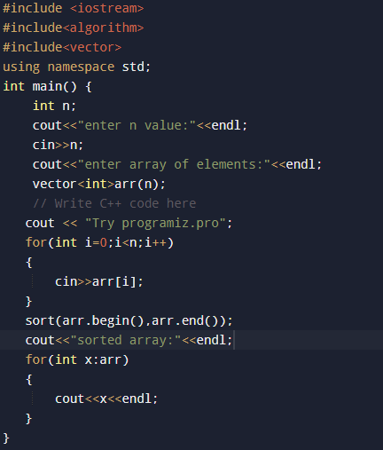

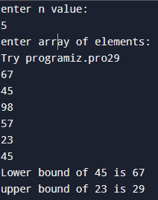
Key Concepts with Definitions/Code Snippet – Hands on Practice
1.Sort
Definition:
Sorts a range in ascending order (by default) using operator<. Not stable. std::sort is a standard C++ algorithm used to rearrange elements in ascending order by default.

Slide 10
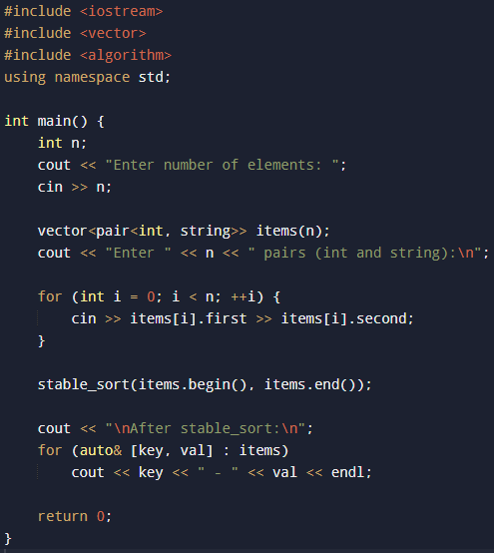
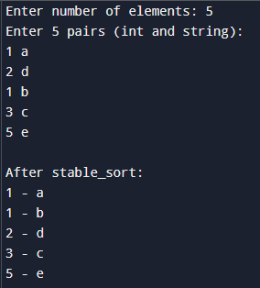
2.StableSort
Definition:
A stable sorting algorithm keeps the original order of items that are equal based on the sorting key.

Slide 11
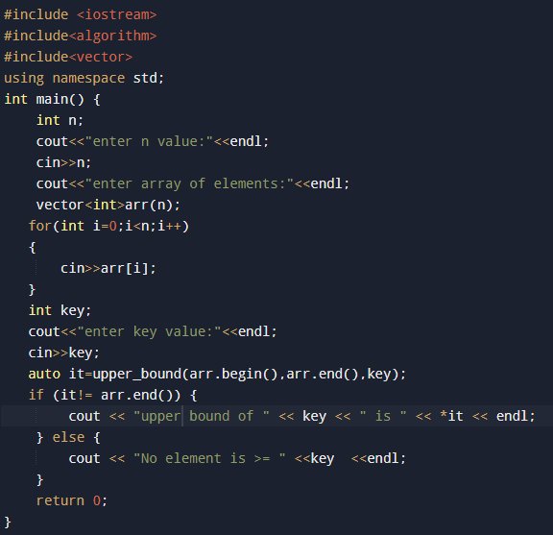
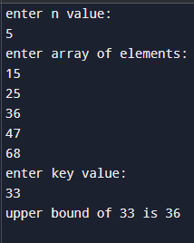
3.LowerBound
Definition:
std::lower_bound is a C++ Standard Library function that returns an iterator to the first element in a sorted range that is greater than or equal to a given value.

Slide 12
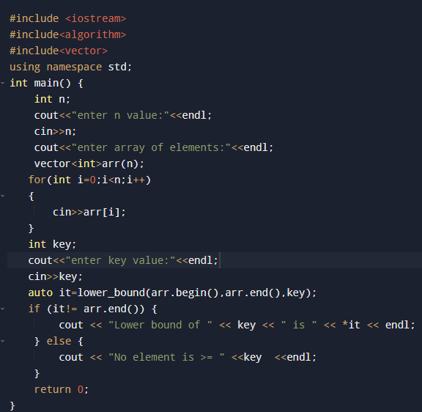
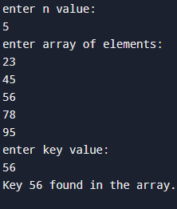
4.UpperBound
Definition:
Returns an iterator to the first element greater than the given value (>)

Slide 13
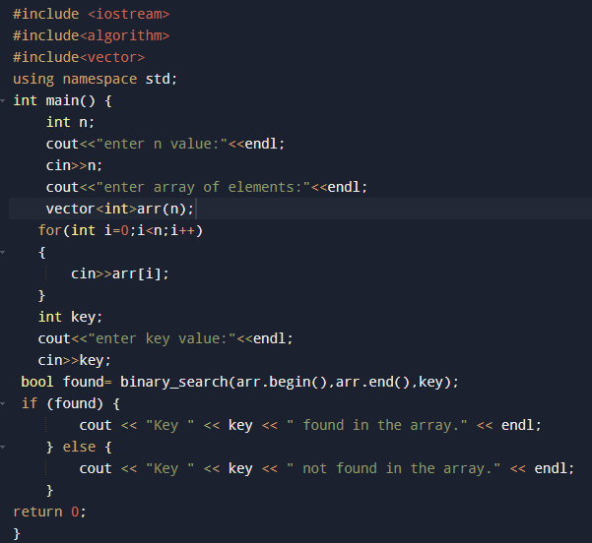
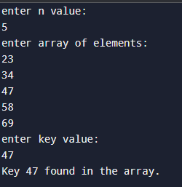
5.BinarySearch
Definition:
It checks whether a given value exists in a sorted range and returns true if found, false otherwise.

Slide 14
Challenges / Debugging Experience
Not sorting the container before calling lower_bound, upper_bound, or binary_search.
Confusing the results of lower_bound and upper_bound, leading to incorrect insert or search logic.
Using sort when stable_sort is needed to maintain the original order of equal elements.
Incorrect custom comparators that lead to unexpected sorting or searching results.
Making off-by-one errors when converting iterators to index positions.
Applying these functions to containers that haven’t been sorted, causing invalid outcomes.
Failing to check for empty containers or handle cases where the target value isn't found.

Slide 15
Additional Learning Resources / Notes
CPP Reference — Comprehensive and official C++ documentation.
cplusplus.com — Beginner-friendly tutorials and examples for STL algorithms.
Containers in C++ STL | GeeksforGeeks
YouTube tutorials — Search for C++ STL algorithms and sorting tutorials.
Practice coding problems on platforms like LeetCode, Codechef.
Experiment with custom comparators to learn more about flexible sorting.

Slide 16
Q&A
Q1: What is the default behavior of sort in C++? A: It sorts elements in ascending order but may change the order of equal elements.
Q2: Why would you use stable_sort instead of sort? A: To keep equal elements in the same order as they appeared originally.
Q3: How does lower_bound help in sorted data? A: It finds the first position where a value can be inserted without breaking the sort (≥ target).
Q4: What is the role of upper_bound? A: It finds where a value would go after all its duplicates (> target).
Q5: What does binary_search check for? A: It quickly verifies if a specific value is present in a sorted range.
Q6: What is a key requirement before using lower_bound, upper_bound, or binary_search? A: The container must be sorted in ascending order.

Slide 17
Plan for Tomorrow
Stacks
Queues

Slide 18
Overall Overview
sort and stable_sort organize elements; stable_sort maintains the relative order of equal values.
lower_bound gives the first position where a value can fit while maintaining sort order (≥ value).
upper_bound finds the position just after the last occurrence of a given value (> value).
binary_search checks whether a value exists in a sorted range, returning true or false.
All of these functions (except sorting) require a sorted container to work correctly.
These algorithms provide efficient operations for locating and inserting elements in sorted data.
To use them effectively, one should understand iterators, different containers, and how to use custom comparators if needed.

Slide 19


Thank You

